Slide 1

CISC Vs RISC
Vishwakarma Institute of Technology,Pune

Slide 2
Outline
RISC Processors
RISC- Features.
CISC Features.
Comparison of RISC & CISC.

Slide 3
Introduction
CISC: Complex Instruction Set Architecture
RISC: Reduced Instruction Set Architecture

Slide 4
Cont..
Reduced Instruction Set Architecture (RISC) –
The main idea behind is to make hardware simpler by using an instruction set composed of a few basic steps for loading, evaluating, and storing operations just like a load command will load data, store command will store the data.
Complex Instruction Set Architecture (CISC) –
The main idea is that a single instruction will do all loading, evaluating, and storing operations just like a multiplication command will do stuff like loading data, evaluating, and storing it, hence it’s complex.

Slide 5
RISC- Features
Simpler instruction, hence simple instruction decoding.
Instruction comes undersize of one word.
Instruction takes a single clock cycle to get executed.
More number of general-purpose registers.
Simple Addressing Modes.
Less Data types.
Pipeline can be achieved.

Slide 6
CISC-Features
Complex instruction, hence complex instruction decoding.
Instructions are larger than one-word size.
Instruction may take more than a single clock cycle to get executed.
Less number of general-purpose registers as operation get performed in memory itself.
Complex Addressing Modes.
More Data types.

Slide 7
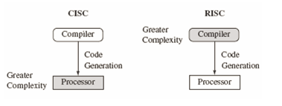
CISC Vs RISC

Slide 8
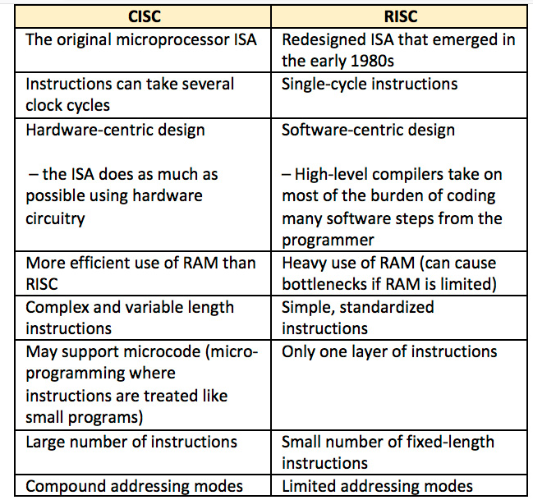
RISC vs CISC

Slide 9
RISC Processors Example
Apple's Power Macintosh line featured RISC-based chips
Windows NT was RISC compatible.
ARM-Advanced RISC Machine.
RC, Alpha, ARC, AVR, PA-RISC, and SPARC.

Slide 10
CISC Processors Example
System/360, VAX, AMD, and Intel x86 CPUs.

